Slide 1

Tasks-time manager
Using threads, locks and so on …

Slide 2
Time manager
The purpose is to build a system that displays a table of tasks that are currently being done and by which employee each task is performed.
The algorithm that we will use to select tasks will output an optimal table for performing tasks (according to pre-determined rules that we will detail shortly)
Each task is divided by type, so tasks of type x can only be performed by an employee of type x.
The system receives via the command line tasks to add/remove (if the same employee has finished performing them) as well as an employee to add/remove.

Slide 3
structure
1.As stated earlier, a task of type x will only be performed by an employee of type x.
2.We will divide the tasks by types and by priority (min, mid, max) so that a task of type x that we want to add to the queue of tasks will be added to the queue with the desired type and the desired priority and will contain the rest of the additional details received on that task.
Let's see an illustration that will demonstrate this

Slide 4



























Slide 5
The principles of the algorithm
1.If in the queue with max priority 3 or more tasks are waiting for execution (fixed), we will only sort the three tasks according to the estimated execution time for the task so that the task with the shortest estimated execution time will be first in the queue ** among those 3 tasks ** (if there are less So for those 2 etc..)
2.If a task that is being performed exceeds the estimated time for execution *1.25 (where 1.25 is fixed) after this time the program will remove the task from the list of tasks being performed and move it to the end of the queue of max priority tasks (of course of the same type).
3.If a constant average time has passed (fixed time), we would like to advance the task at the top of the min queue to the end of the mid queue and the task at the top of the mid queue to the end of the max queue.
4.If the user removes any task that is currently being performed, we will immediately provide the employee who performed it with a new task to perform, the task that is at the top of the queue max.

Slide 6
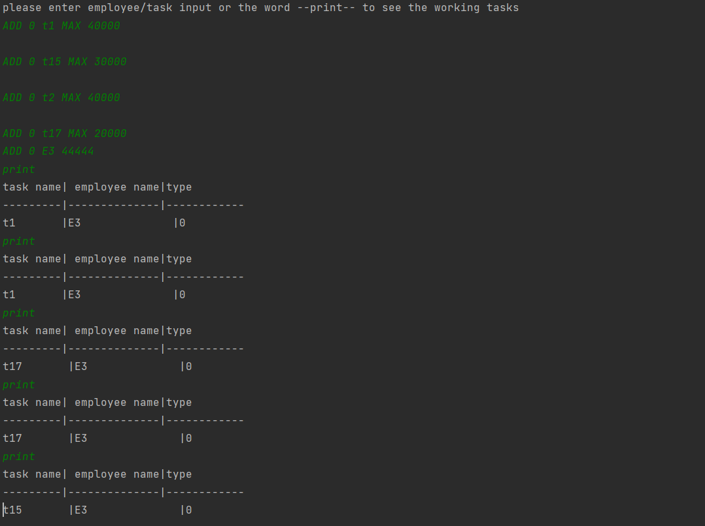

Slide 7
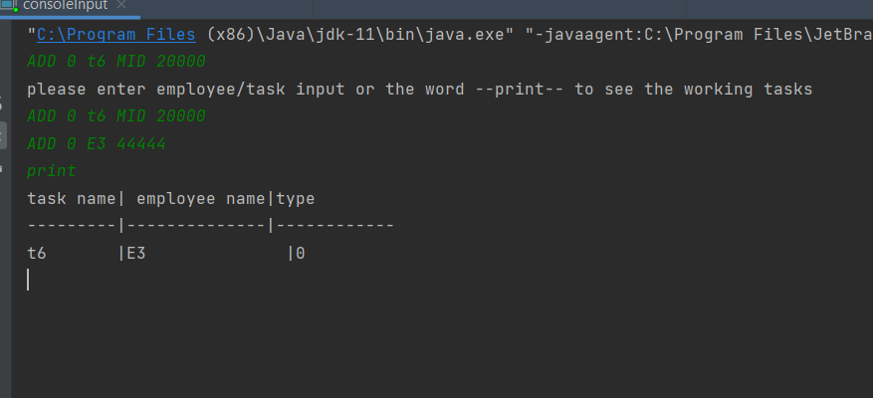

Slide 8
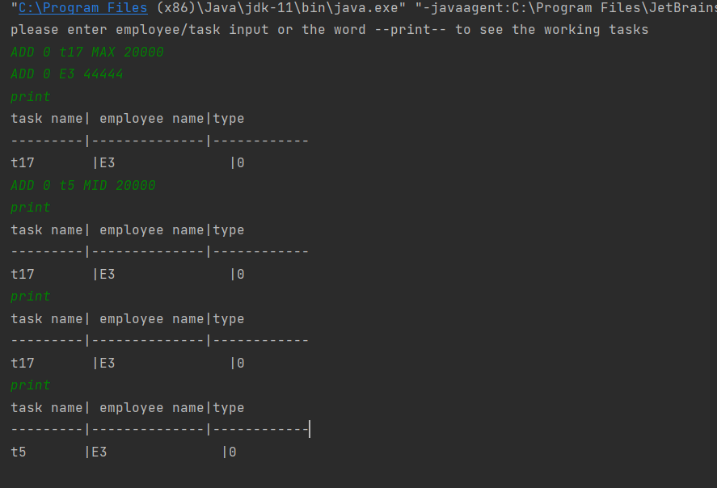

Slide 9
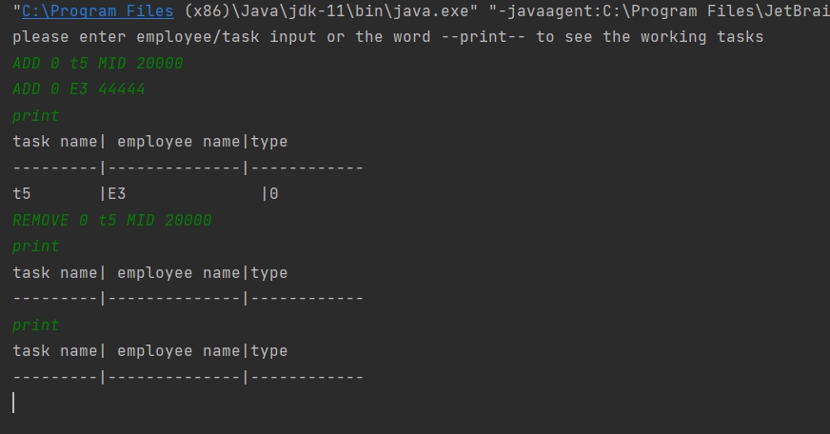

Slide 10
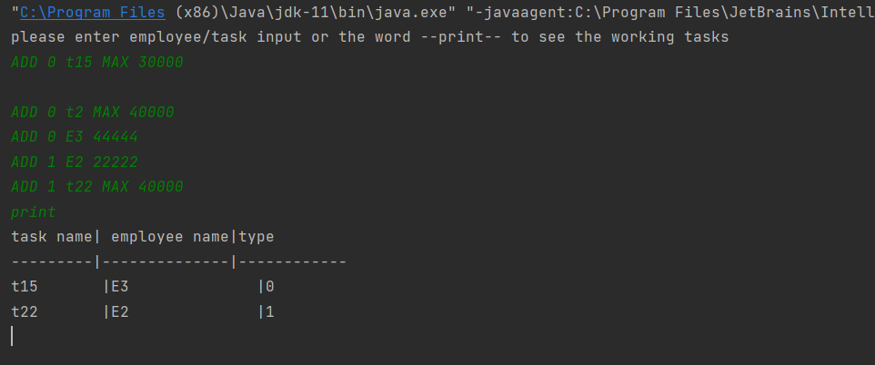

Slide 11





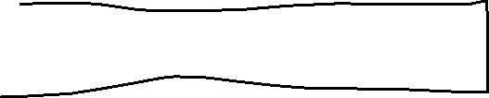



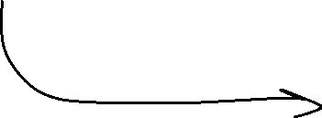






Slide 12

















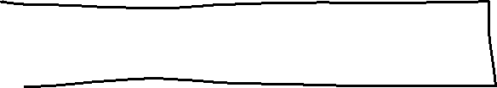

Slide 13











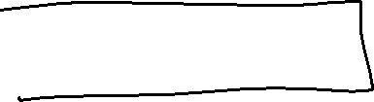
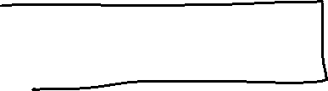

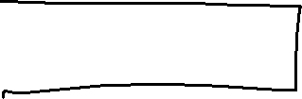




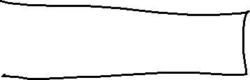



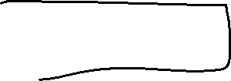

Slide 14












ADD 1 t1 MID 20000

Slide 15
How will we manage all the queues of different types? Threads!
1. A thread that will be responsible for listening to input from the console line only.
2. For each type of task:
-A thread that will be responsible for receiving input related to a task or worker (add/remove) from the listening thread and receive it according to the input
- A thread that will be responsible for preempting tasks (switching from min to mid and from mid to max) in addition to replacement, if there is a task that exceeds the maximum time allowed for its execution (maximum time - average time to execute a task)

Slide 16

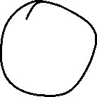

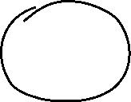


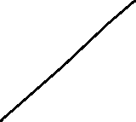



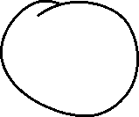



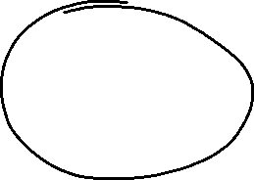
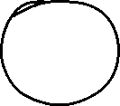

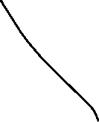

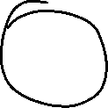

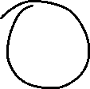

Slide 17
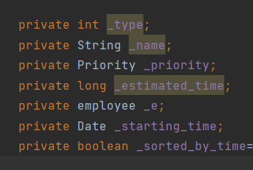
task

Slide 18
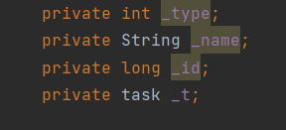
employee

Slide 19
extras
1.Radix-for getting input
2.Synchronization and locks.
3.threads

